Slide 1
Presented by: Sanjida Akter
ID: IS-23
Batch: IS-10
Course name: IT Support for Office Management
Submitted to:
Md. Fahmidur Rahman Sakib
Lecturar dept of CSE
Metropolitan University,Sylhet

Slide 2
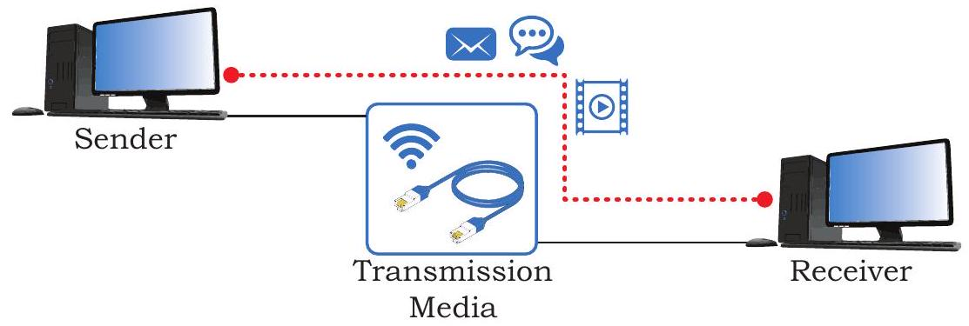
Introduction to Data Communication
Definition: The process of transmitting data between two or more
devices through a communication medium.
Core Components:
Sender: Device sending the data.
Receiver: Device receiving the data.
Medium: Physical or wireless pathway for data transmission.
Protocol: Rules governing communication.
Importance:
Enables connectivity and collaboration.
Forms the backbone of IT systems.

Slide 3
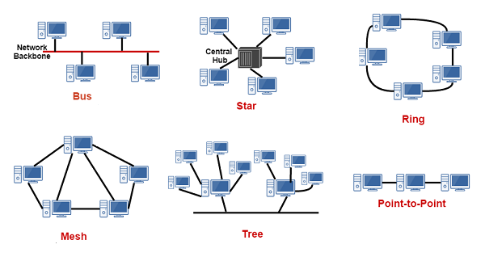
Understanding Network Topologies
What Are Topologies?
The physical or logical arrangement of devices in a network.
Types of Network Topologies:
Bus Topology:
Single backbone cable; simple but prone to failures.
Star Topology:
Devices connect to a central hub; easy to manage.
Ring Topology:
Devices form a closed loop; data travels in a sequence.
Mesh Topology:
Multiple connections for high reliability.
Hybrid Topology:
Combines elements of different topologies.

Slide 4
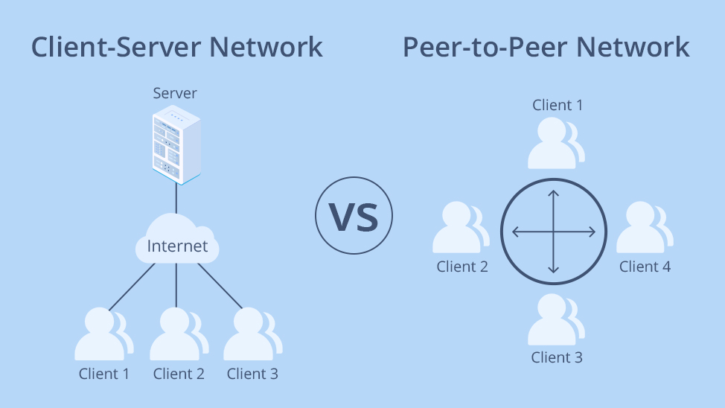
Network Architectures
Definition: The design and structure of a network system.
Key Types:
Client-Server Architecture:
Centralized system where a server provides resources to clients.
Example: Web servers and email servers.
Peer-to-Peer (P2P) Architecture:
Decentralized; devices share resources directly.
Example: File sharing systems.
Hybrid Architecture:
Combines client-server and P2P features.
When to Use Each:Small-scale collaboration: P2P
Large-scale enterprise: Client-server

Slide 5
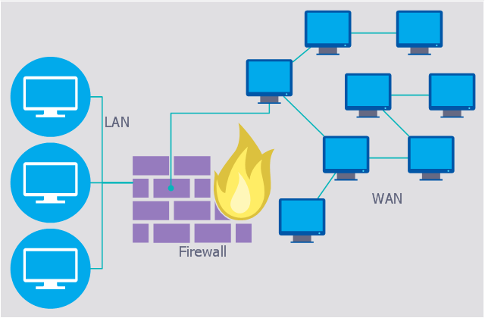
Network Connectivity Option
Local Area Network (LAN):Small area like homes or offices.
High-speed and cost-effective.
Metropolitan Area Network (MAN):Covers a city or campus.
Connects multiple LANs with moderate speed.
Wide Area Network (WAN):Spans large geographic areas, like countries.
Relies on public infrastructure (e.g., ISPs).
Emerging Connectivity Trends:5G Networks: High-speed wireless WAN.
IoT Networks: Connecting smart devices.

Slide 6
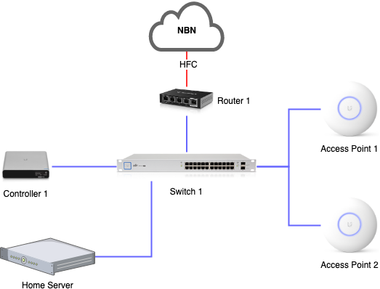
Configuring Network Devices
Routers:
Direct data between networks.
Configuration Steps:
Access router’s web interface.
Set up IP addresses and routing protocols.
Enable security features (e.g., firewall, WPA).
Switches:
Connect devices in a LAN.
Configuration Steps:
Assign VLANs to segregate traffic.
Configure port settings and security.
Access Points:
Provide wireless connectivity.
Configuration Steps:
Set SSID and passwords.
Adjust channel and frequency settings.

Slide 7
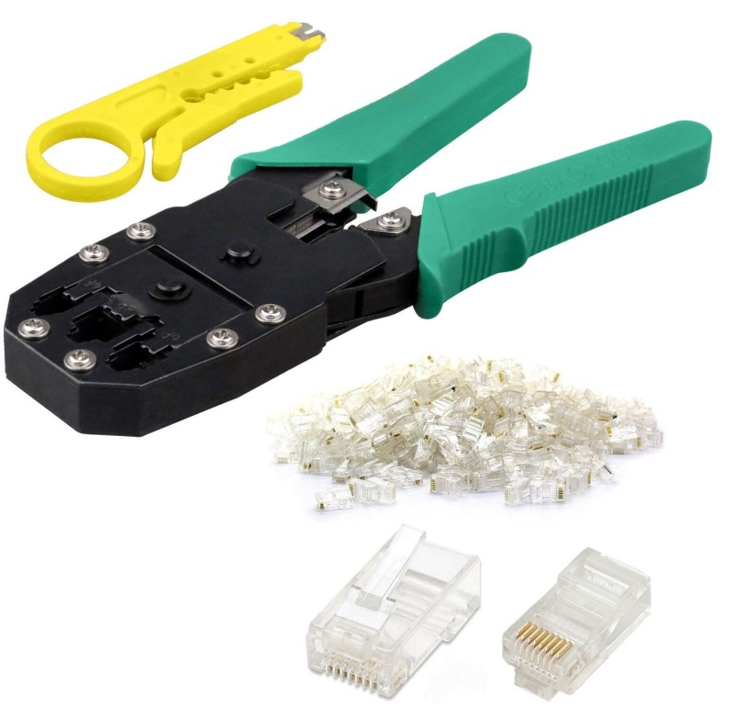
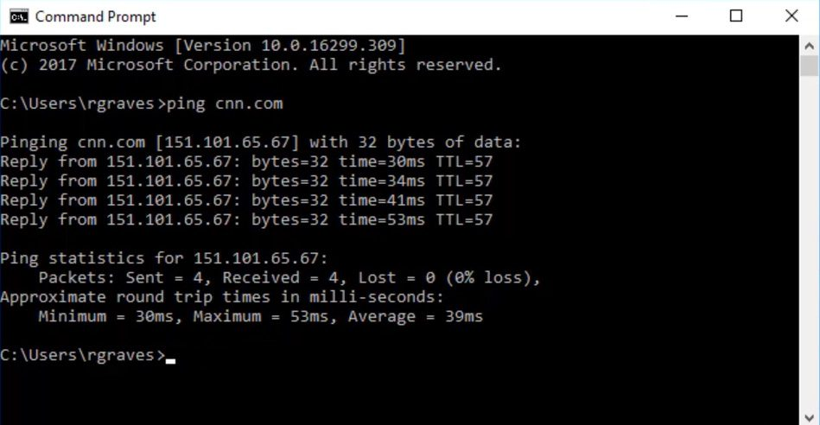

Networking Tools
Hardware Tools:
Crimping Tool: Attaches connectors to Ethernet cables.
Cable Tester: Verifies cable functionality and connectivity.
Punch-Down Tool: Secures wires in patch panels.
Software Tools:
Ping/Traceroute: Test connectivity and identify bottlenecks.
Wireshark: Analyze network traffic for troubleshooting.
Network Monitoring Software: Monitor performance and detect issues ( SolarWinds, Nagios).

Slide 8
Best Practices in Networking
Secure Network Infrastructure:Use firewalls, encryption, and strong passwords.
Maintain Updated Firmware:Keep routers, switches, and APs up to date.
Regular Backups and Documentation:Maintain backups of configurations and logs.
Implement Monitoring Systems:Track bandwidth and detect unauthorized access.
Test Regularly:Perform periodic recovery and failover tests.

Slide 9
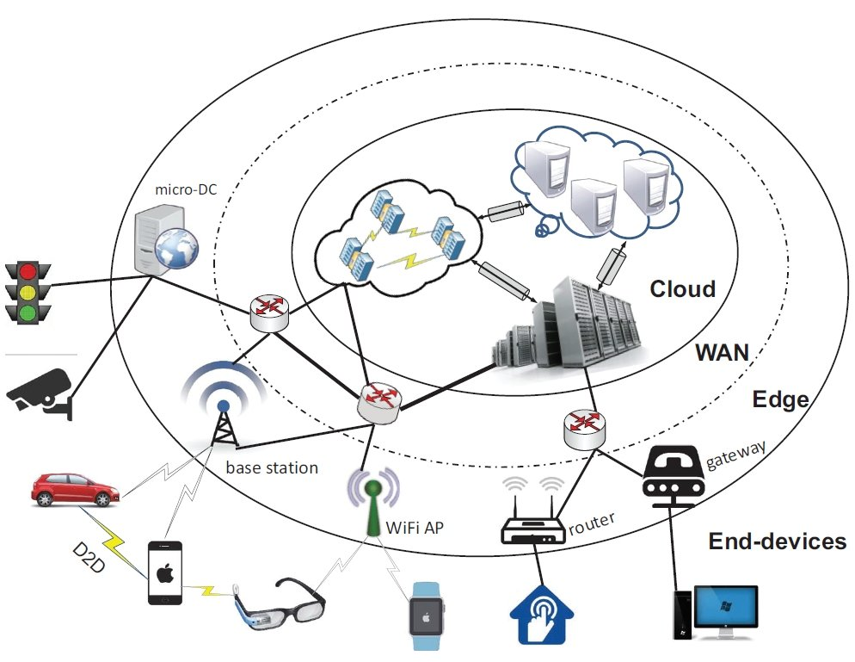
Future Trends in Data Communication
5G and Beyond: Faster and more reliable wireless connectivity.
Software-Defined Networking (SDN): Programmable, flexible networks.
Edge Computing: Processing data closer to the source.
Artificial Intelligence in Networking: Automated monitoring and troubleshooting.

Slide 10
Thank You

